Slide 1
Best School Prediction

Slide 2
Overview
Pain Point
Existing System
Proposed System

Slide 3
DATASET
Business Usecase
Features
Target Variable
Categeroised Variable

Slide 4
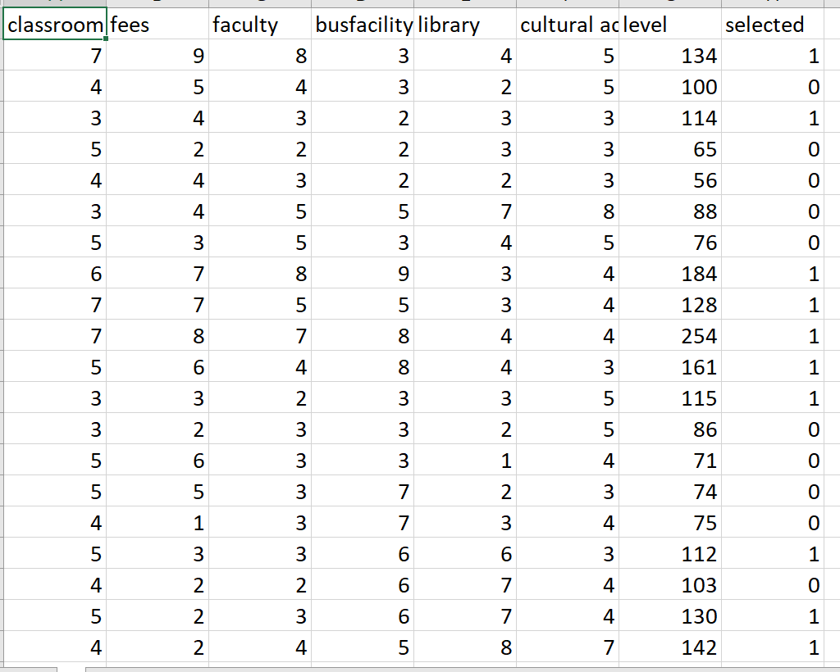

Slide 5
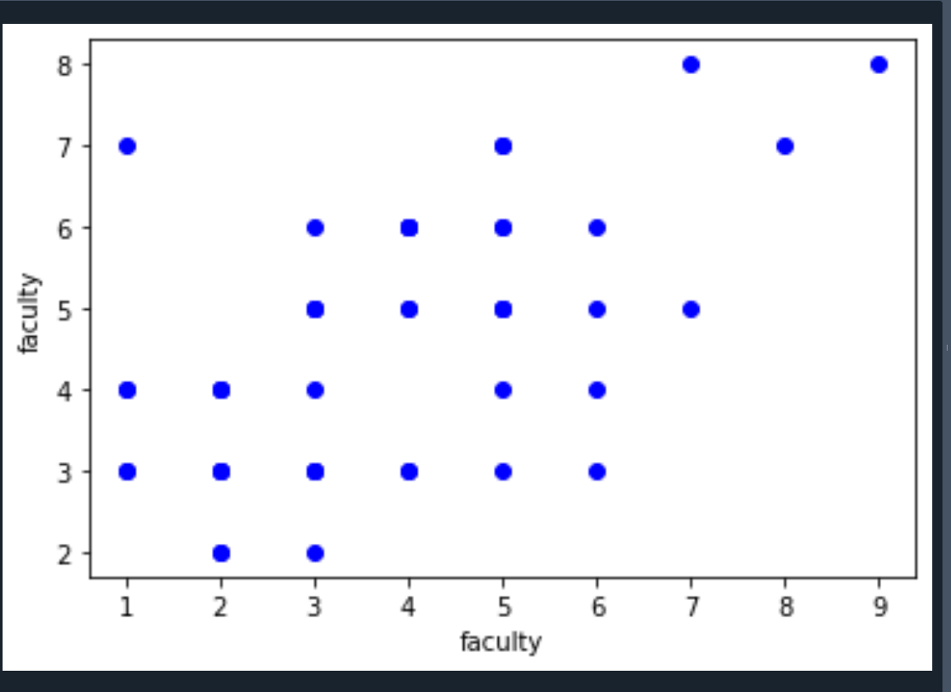
Observation

Slide 6
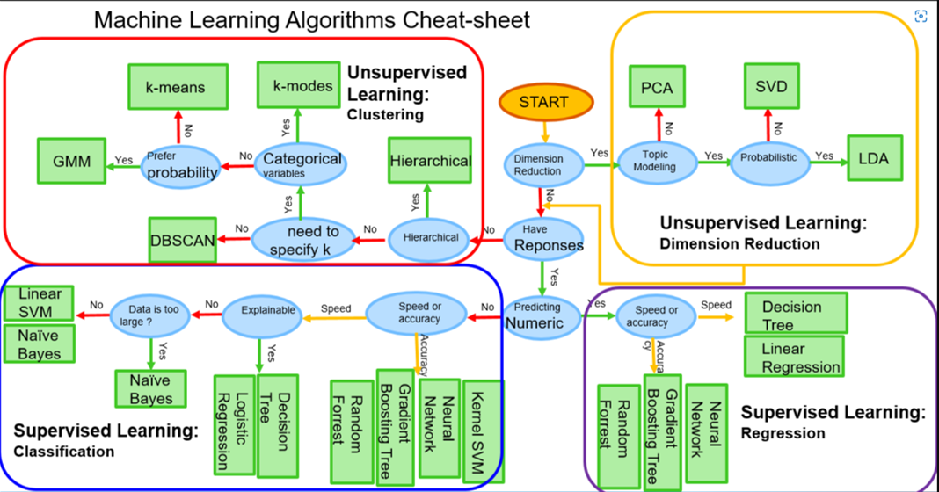
model Selection

Slide 7
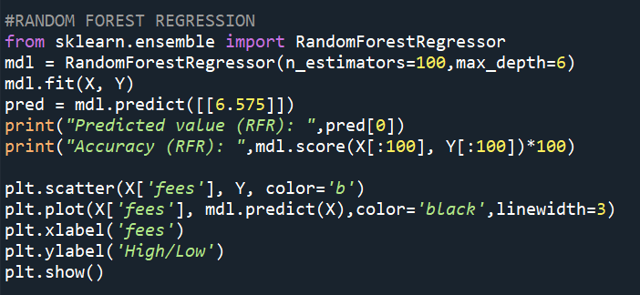
Code

Slide 8
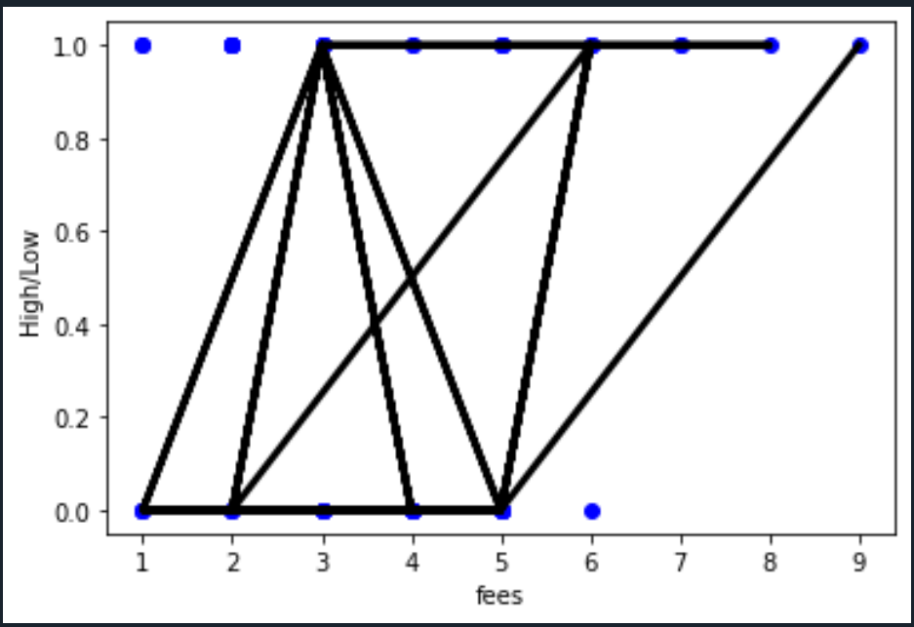
Result

